Slide 1
The Danube Water Program and Regional Benchmarking Activities
Philip Weller, IAWD
Novi Sad, April 19, 2016

Slide 2
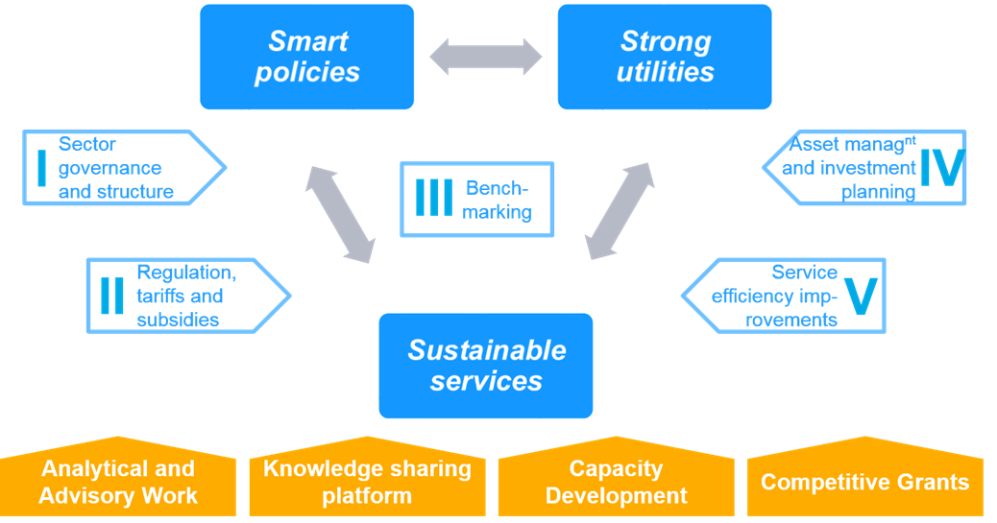
The DWP Framework

Slide 3
Phase I status and achievements

Slide 4
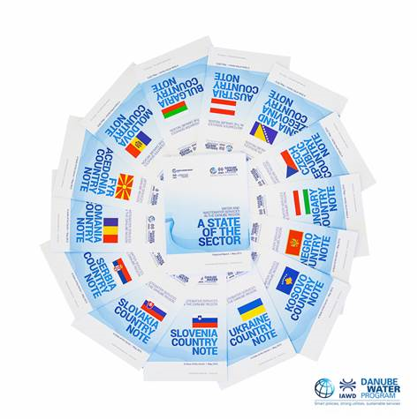
Analytical and Advisory work
At regional level
State of the Sector: launched
Supporting papers
At national level
Sector reform workshop in Croatia
PPP / outsourcing in Kosovo
Policy advice in Albania
TA on EU / price recovery in Serbia
SoS dissemination in Albania, Hungary, Kosovo, Romania

Slide 5
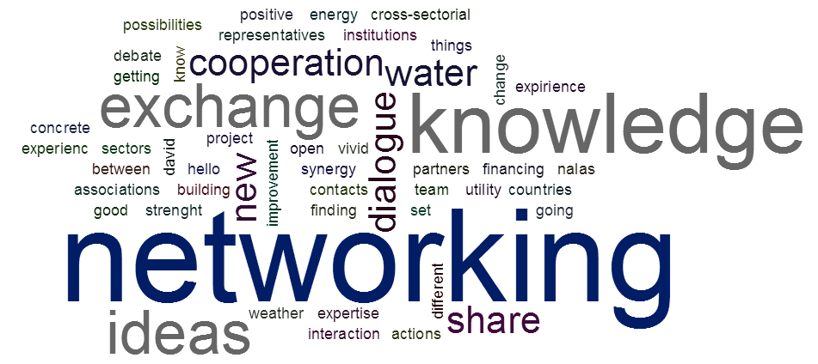
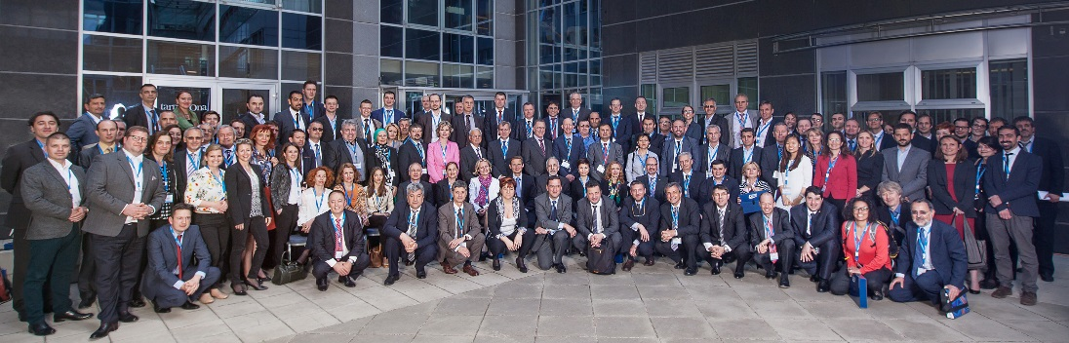

Knowledge Sharing
Annual Danube Water Conference (May 7-8)
150 experts from 20 countries
Based on the SoS report
DANUBIS
Data on 600 utilities from 14 countries over 19 years, plus recent news, events, research etc.
5000 users from 100 countries in 8000+ sessions
Significant upgrade on-going

Slide 6
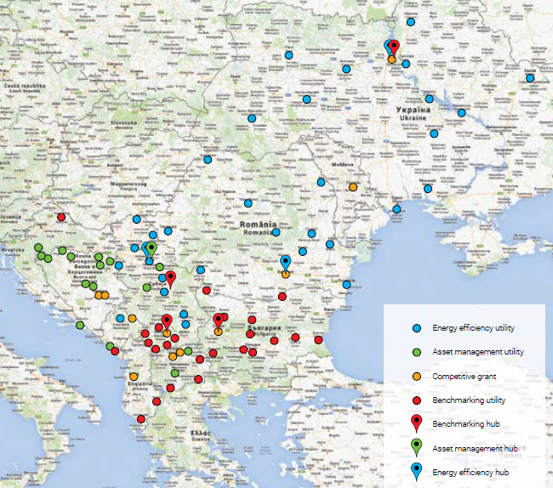
Capacity Building activities
Asset Management | 1 hub | 18 utilities | 4 countries | Completed
Energy Efficiency | 3 hubs | 33 utilities | 6 countries | Completed
Utility benchmarking | 4 hubs | 57 utilities | 8 countries | 2 Cycles
Commercial Practices | 3 hubs | 21 utilities | 4 countries | Completed
Asset Management 17 asset registry systems established
Energy Efficiency 17 energy audits, 10M investments identified, 35% energy savings, 2 years payback period
Utility Benchmarking 4 Hubs fully operational and 57 detailed utility benchmarking reports completed in 2nd Year
Commercial Efficiency 19 Business plans produced

Slide 7
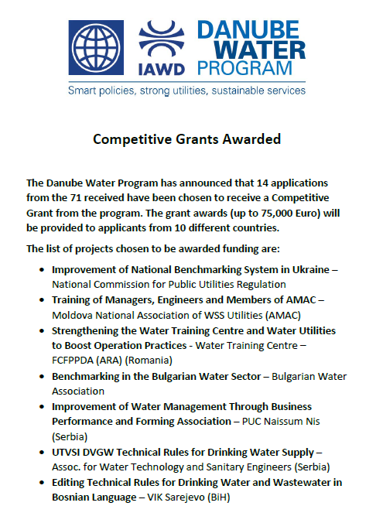
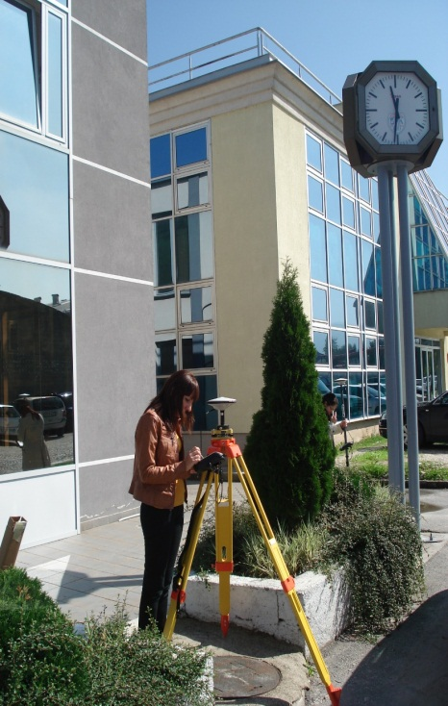
competitive grant window
13 completed grants in 9 countries (700K € total), for example:
Water Utility Kumanovo, Macedonia – NRW reduction program established with 5% reduction achieved in a pilot zone
Water Utility East Sarajevo, BiH – complete primary and secondary network registered in the Geographical Information System (GIS)
Water Associations of Serbia and BiH – cooperation on translating and editing of 22 DVGW technical rules; training of trainers program
Regional cooperation – Water Utilities from Montenegro, Serbia and BiH: supply of hardware and software for GIS and billing system, systematic water metering established
40 Water Utilities in Moldova – retraining of managers and technical staff by the Technical University of Moldova
14 Water Associations in the program region – development of a Strategic Business Plan (implemented by SHUKALB)
Water Association Romania – development of 1 training curriculum for water operators (e.g WWTP operation, development of NRW strategy)

Slide 8
Phase II Work Plan
Danube Water Program

Slide 9
The Vision and Structure
Long term vision
Establish durable network of water services professionals
Consolidate and maintain knowledge on State of Sector
Develop self-financed capacity-building curriculum
Same overall structure and implementation arrangements
Stronger focus on establishing sustainable mechanisms
6M € incl. co-financing
Three-year extension (Oct. 2015 to Dec 2018)

Slide 10
Components
Component 1
Analytical and Advisory work
Program Implementation Support
Component2
Capacity & Knowledge Sharing
Competitive Grants
Project Management
Waterworks Associations Strengthening

Slide 11
Associations Strengthening
Objective
Strengthen the water utility associations and improve their capacity to become self sustainable
Allocate Funds to each Association (Total 500K Euro) to support Business Planning and Program Implementation with focus on capacity building (not all funds secured)

Slide 12
Associations Strengthening
RESOURCES Committed to Strengthen National Water Utility Associations
Business Plan and Association Strategy – 5,000 Euro
Program Implementation Support – up to 20,000 Euro (possible two rounds)

Slide 13
Capacity Building
RESOURCES COMMITTED for CAPACITY BUILDING PROGRAMS
Continuation of Existing Programs
Development of new Initiatives
Support for Regional Capacity Building Partnership
Efforts to secure additional Funding

Slide 14
Capacity Building Principles
Quality. Common quality standards
Partnership. Training materials and capacities shared regionally.
Customization. Delivery by national associations (with technical partners) in local language and in-country (region)
Sustainability. Recurrent costs covered by utilities
Results. Capacity-building programs aiming at concrete outputs and outcomes

Slide 15
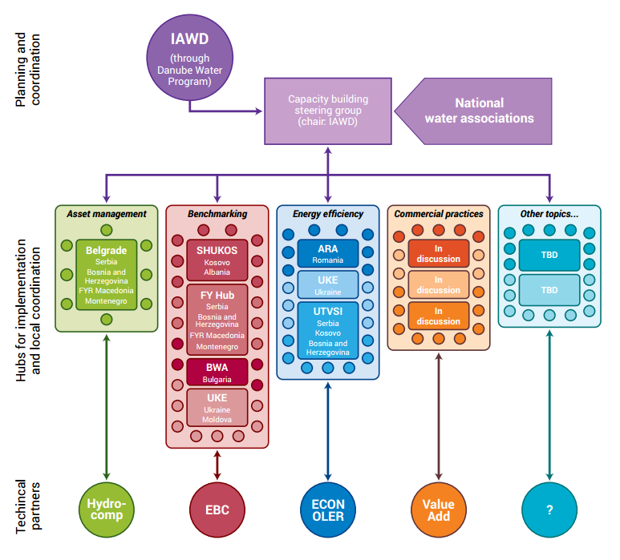
The vision
IAWD and WW associations setup a regional Capacity Building curriculum…
focused primarily on complex utility challenges…
delivered by sub-regional hubs (WW associations)…
With the help of technical partners as needed

Slide 16
Benchmarking A Foundation for Utility Improvement

Slide 17
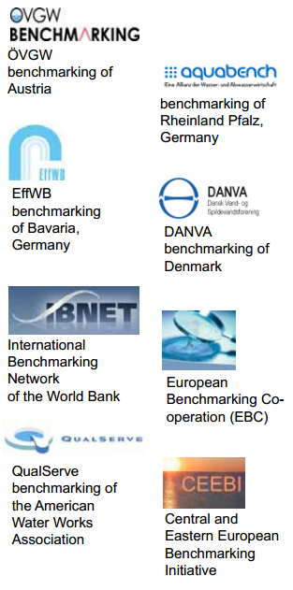
A way to improve performance
Benchmarking is the process of comparing one's business processes and performance metrics to industry bests and best practices from other companies.
For decision makers
Regulation Body of Knowledge “A means of quantifying the relative performance of companies or divisions (such as regional distribution companies)”
For actors
International Water Association “A tool for performance improvement through systematic search and adaptation of leading practices”.

Slide 18

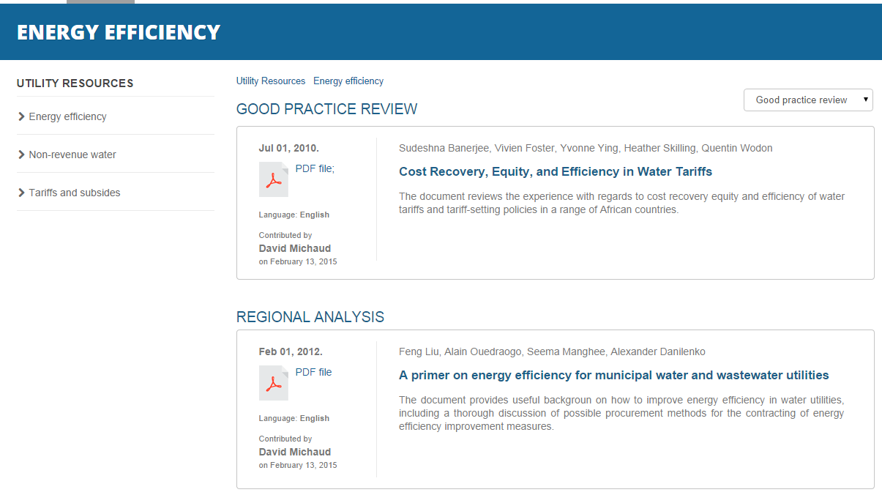
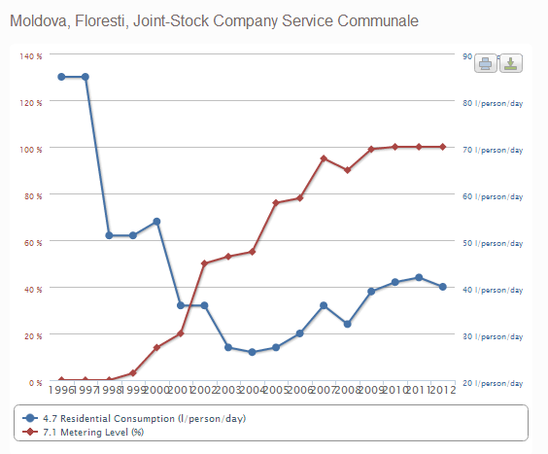
The DANUBIS water platform is an online repository of resources for and about water and sanitation utilities in the Danube region.
For Local Governments: obtain national benchmarks
For utilities: obtain resources and national / international benchmarks
For regulators, ministries: make information available; obtain international benchmarks

Slide 19
Benchmarking…
BENCHMARKING:
Cannot take into account all local circumstances
Doesn’t replace expert opinion
BUT:
Is a way to start a discussion on performance
Can help create a culture of tracking results
And focusing on challenges and improvements

Slide 20
Competitive Grants
RESOURCES COMMITTED FOR COMPETITIVE GRANTS
Two Rounds of CGW envisaged each with a value of 500,000 Euro each
First call for Proposals early 2016 and Agreements signed in spring 2016
Grants of up to 50,000 Euro with cofinancing considerably increased

Slide 21

IAWD and IWA Cooperation
IAWD as Regional Partner
IWA/IAWD MOU in preparation
Knowledge Management and Capacity Building

Slide 22
Philip Weller IAWD Danube Water Program Coordinator ++43 (0) 1 217 07 48 weller@iawd.at
Thank you
www.danube-water-program.org

