Slide 1
How to Operate
Stanford CS183B
Keith Rabois
November 6, 2014

Slide 2
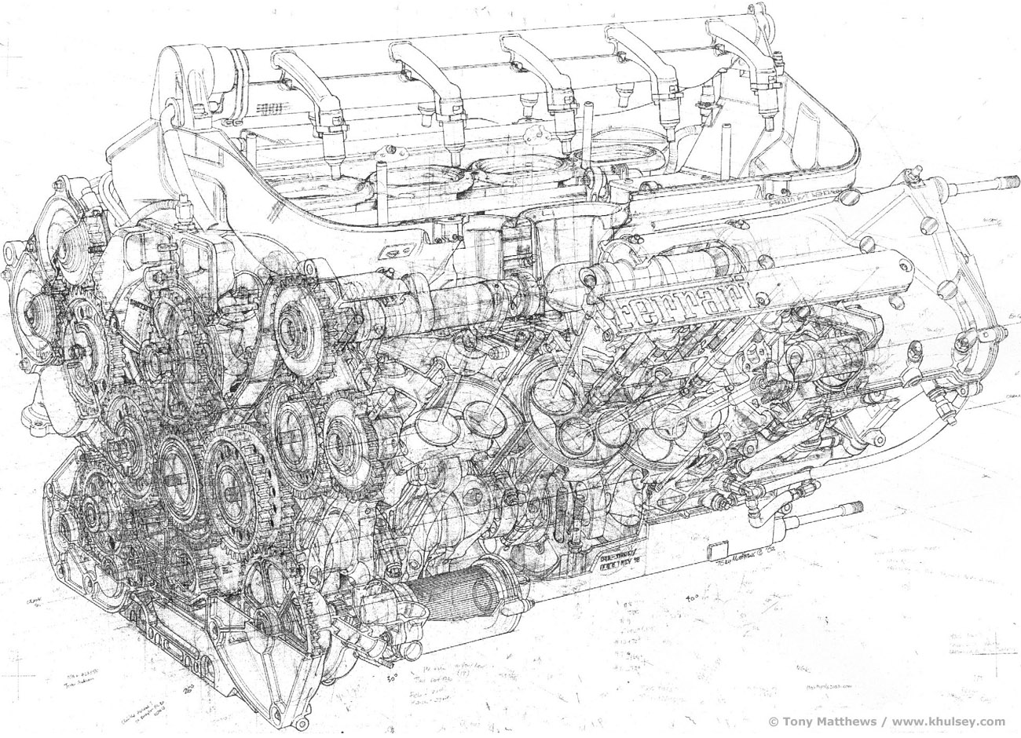

Slide 3
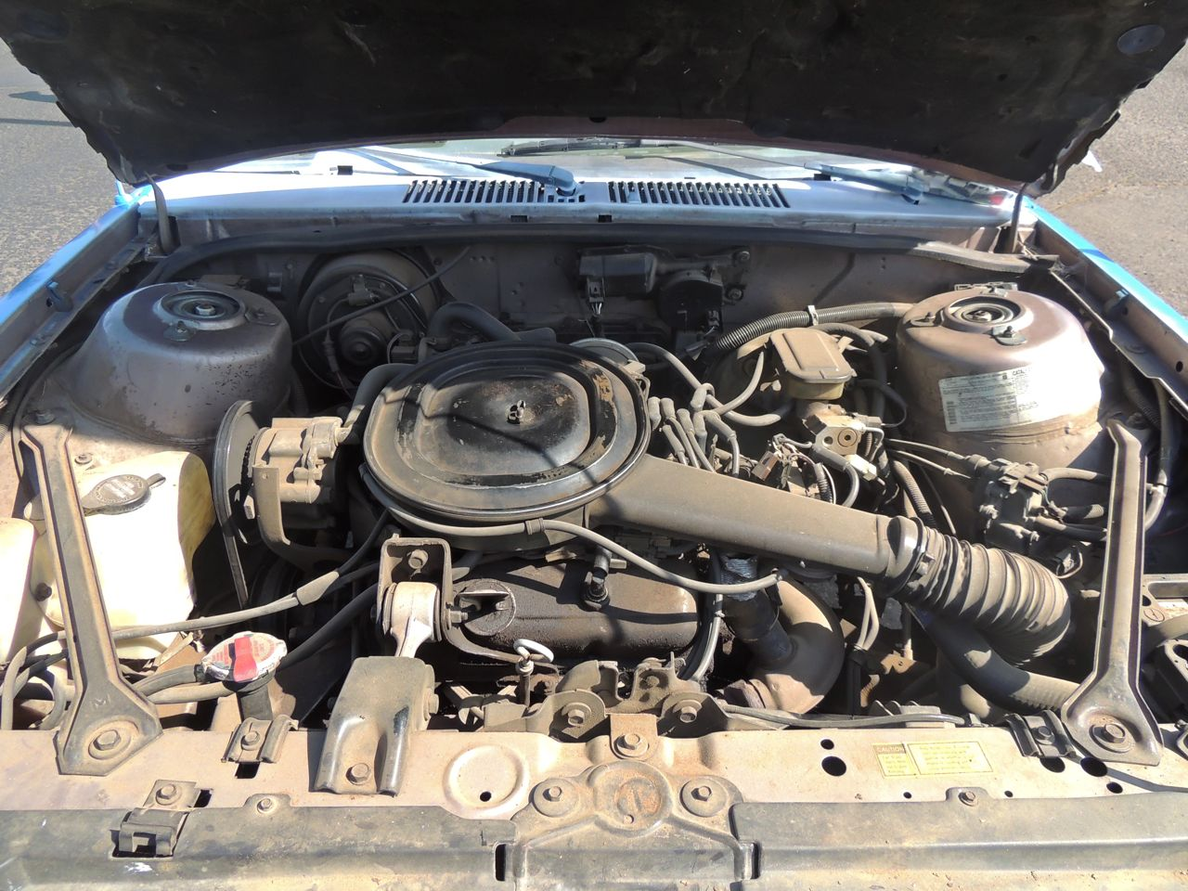

Slide 4
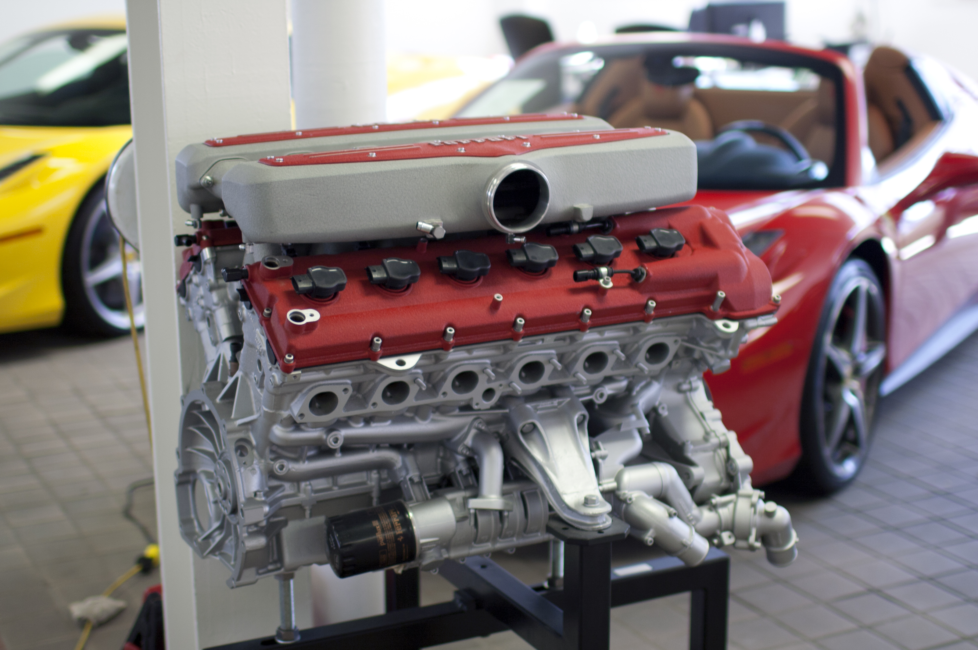

Slide 5


Slide 6
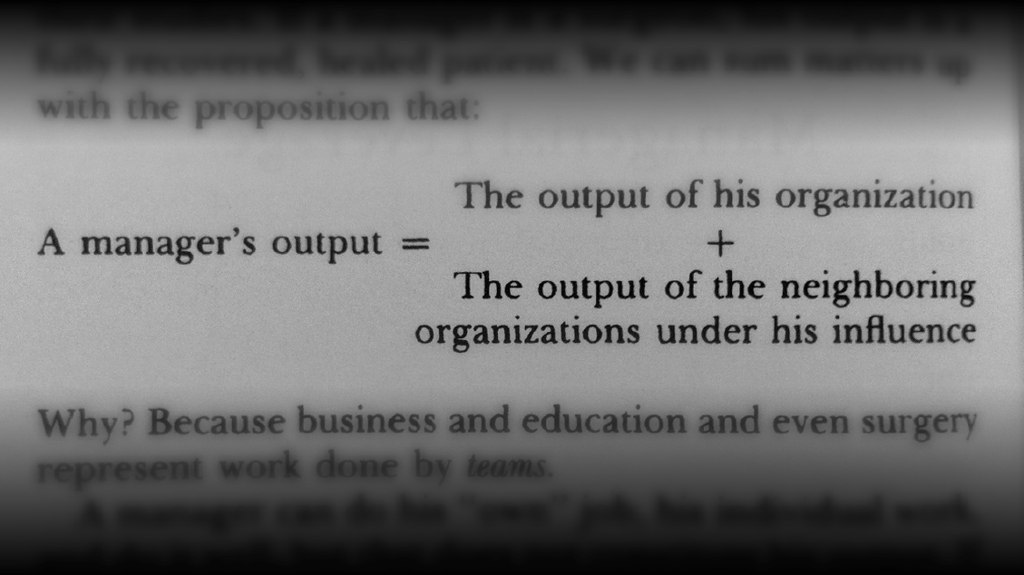

Slide 7

Triaging

Slide 8

Editing

Slide 9
1. Simplify

Slide 10
"Ask not what your country can do for you, ask what you can do for your country."
John F. Kennedy

Slide 11
"Give me liberty or give me death!"
Patrick Henry

Slide 12
"We have nothing to fear
but fear itself.”
Franklin Delano Roosevelt

Slide 13


Slide 14


Slide 15
2. Clarify

Slide 16
3. Allocate Resources

Slide 17
4. Ensure Consistent Voice

Slide 18
5. Delegate

Slide 19
Abdicate vs. Micromanagement

Slide 20
Abdicate vs. Micromanagement
X

Slide 21
Task-Relevant Maturity
Low
High
Highly structured: what, when, how
Monitor and set objectives

Slide 22
? | Step in. Decide. Overrule.
Delegate fully | ?
High
Level of conviction
Low
Low
High
Consequences of Decision

Slide 23
6. Edit The Team

Slide 24
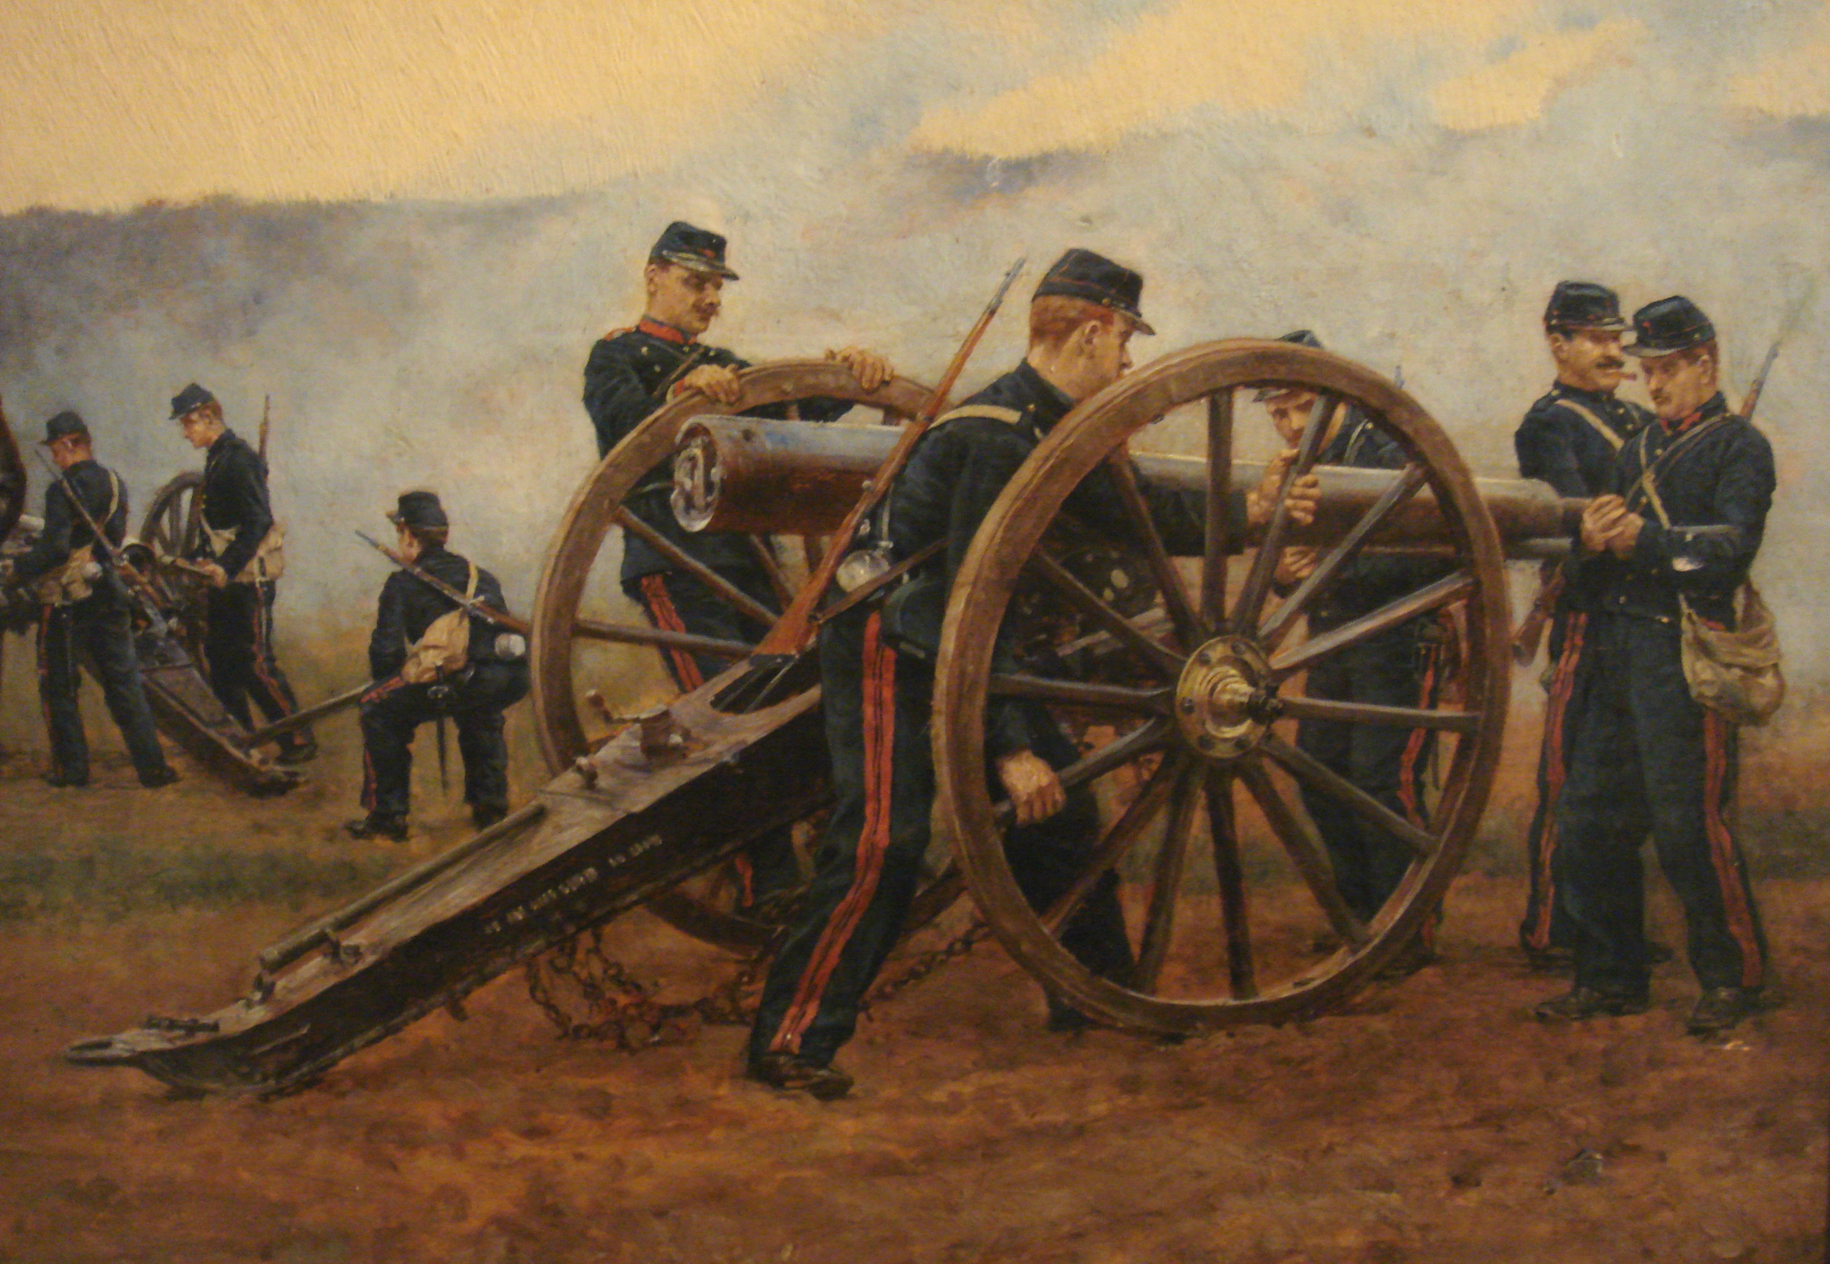
Barrels & Ammunition

Slide 25
Scaling
Company growth rate
Growth
Employee’s personal growth rate

Slide 26
Insist on Focus

Slide 27
Metrics & Transparency

Slide 28
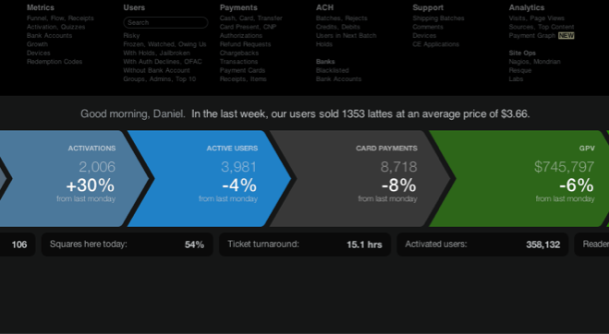


Slide 29
Gathering & Simplifying Information
Goal: predict output to enable you to adjust
Should measure output, not activity
Pairing indicators: measure effect & counter effect
Release criteria vs. ship date
Number of hires vs. quality of hires
Loss rate vs. false positive rate

Slide 30
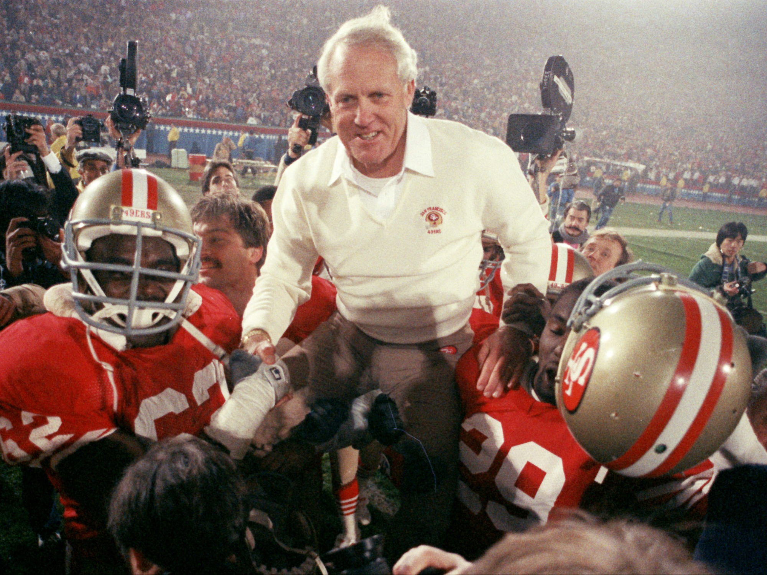
Details Matter

Slide 31
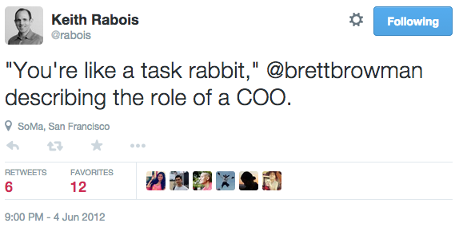

Slide 32
“Do you know how to tell if you’re doing the job? If you’re up at 3 AM every night talking into a tape recorder and writing notes on scraps of paper, have a knot in your stomach and a rash on your skin, are losing sleep and losing touch with your wife and kids, have no appetite or sense of humor, and feel that everything might turn out wrong, then you’re probably doing the job.”

