Slide 1


Process benchmarking in water utilities in Bulgaria" within the competitive grant scheme operated by the provisions of the grant agreement TF012722, signed between the International Association of water supply utilities in the Danube region (IAWD) and the World Bank
Novi sad, 19.04.2016

Slide 2
Results 2014, examples, key findings (1/7)
12 participating WSSCs
Name of organisation | Country | Supply Area (km²) | Population supplied (no.)
Sofyiska Voda AD | Bulgaria | 1.340 | 1.309.634
ViK AD Lovech | Bulgaria | 3.239 | 103.303
ViK Burgas | Bulgaria | 7.400 | 415.063
ViK EOOD Blagoevgrad | Bulgaria | 4.104 | 205.725
ViK EOOD Pazardjik | Bulgaria | 1.003 | 153.188
ViK EOOD Plovdiv | Bulgaria | 5.973 | 715.252
ViK EOOD St.Zagora | Bulgaria | 5.858 | 346.500
ViK EOOD Vidin | Bulgaria | 3.032 | 100.419
ViK EOOD Yambol | Bulgaria | 3.335 | 128.432
ViK OOD Gabrovo | Bulgaria | 1.088 | 86.324
ViK OOD Ruse | Bulgaria | 2.803 | 248.483
ViK OOD Vratza | Bulgaria | 3.619 | 196.893

Slide 3
Results 2014, examples, key findings (2/7)
Internal Analysis
Prepared at the end of 2014 – comparison only between 12 participating WSSCs
For the purpose of data collection - have been developed unified templates based on the methodology of EBC
Internal tool for data aggregation and output charts with the results for analysis
Prepared 12 individual and one summary comparative analysis report

Slide 4
Results 2014, examples, key findings (3/7)
Key findings
Large differences in the values of individual PIs of the 12 compared WSSC as this is typical for all functional areas
Distortions in the share of individual types of costs in the different utilities; higher costs hide reserve optimization
Significant reserve for increasing energy efficiency in the sector: only 4 of the 12 water utilities use cogeneration and only 2 recover energy
Lowest are differences between the WSSC regarding indicators for water quality and collection

Slide 5
Results 2014, examples, key findings (4/7)
Examples: Water loses

Slide 6
Results 2014, examples, key findings (5/7)
Examples: Collection

Slide 7
Results 2014, examples, key findings (6/7)
Examples: Cost coverage ratio, water service

Slide 8
Results 2014, examples, key findings (7/7)
Conclusion 2014:
These analyses should be used:
as a starting point for tracing reasons in order to detect deficiencies in given processes;
identifying areas for improvement
exchange of good practices between utilities, aimed at improving the work of each of them.

Slide 9
Results 2015, examples, key findings (1/2)
4 new utilities joined the project (total number 16):
Name of organisation | Country | Supply Area (km²) | Population supplied (no.)
Sofyiska Voda AD | Bulgaria | 1.340 | 1.309.634
ViK AD Lovech | Bulgaria | 3.239 | 103.303
ViK Burgas | Bulgaria | 7.400 | 415.063
ViK EOOD Blagoevgrad | Bulgaria | 4.104 | 205.725
ViK EOOD Pazardjik | Bulgaria | 1.003 | 153.188
ViK EOOD Plovdiv | Bulgaria | 5.973 | 715.252
ViK EOOD St.Zagora | Bulgaria | 5.858 | 346.500
ViK EOOD Vidin | Bulgaria | 3.032 | 100.419
ViK EOOD Yambol | Bulgaria | 3.335 | 128.432
ViK OOD Gabrovo | Bulgaria | 1.088 | 86.324
ViK OOD Ruse | Bulgaria | 2.803 | 248.483
ViK OOD Vratza | Bulgaria | 3.619 | 196.893
ViK OOD Silistra | Bulgaria | 2.850 | 116.626
ViK OOD Turgoviste | Bulgaria | 1.720 | 85.115
ViK OOD Kurdjali | Bulgaria | 3.209 | 135.578
ViK EOOD Haskovo | Bulgaria | 4.255 | 166.687

Slide 10
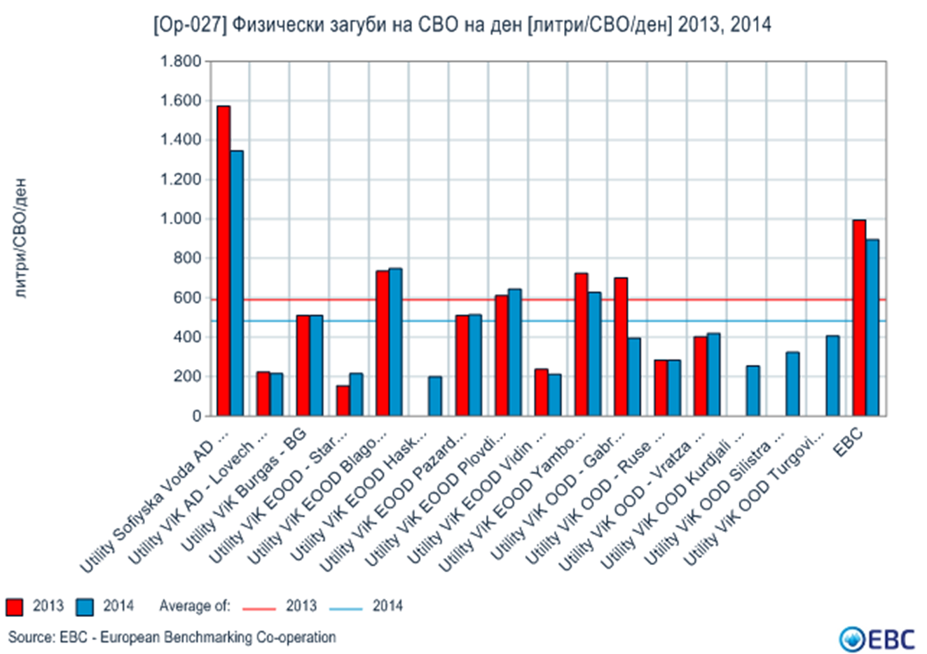
Results 2015, examples, key findings (2/2)

Slide 11
Third phase 2016
Preparation for 2016 activities:
Change the approach – move from analysis to real actions
Identify areas where you can “win” relatively fast (quick wins)
Find necessary resources to apply this approach
Prepare detailed action plan
Inform WSSCs for potential areas for improvements
Hire appropriate experts + representatives from the best WSSCs from benchmarking
Continue with benchmarking in parallel with improvements process
Invite new participants to join the project

Slide 12
Conclusions
Time to touch benefits is relatively long – 3-5 years…
Most of the problems related to the smooth implementation of the project are dictated by what is happening and upcoming changes related to the implementation of water reform in Bulgaria.
WSSCs haven’t enough resources as manpower and time
A lack of stability in management of the utilities (political influence) - For many of them projects such as benchmarking, can reveal the true results for managed by them utility, which in many cases can be used (although the project ensure anonymity) as a tool for their replacement
Experience from benchmarking was used in the preparation of new regulatory legislation (part of the PI and definitions)

Slide 13
Thank you for your attention!

