Slide 1
Utility benchmarking in Western Europe
Peter Dane
19 April 2016
YOUR PORTAL TO EUROPEAN BEST PRACTICES

Slide 2
Outline
About EBC
The benchmarking rationale
EBC’s benchmarking programme
Lessons learned and challenges ahead

Slide 3

About EBC
The European Benchmarking Co-operation (EBC Foundation) is an industry-based, not-for-profit benchmarking initiative for drinking water- & wastewater services
initiated by Dutch- & Nordic national water utility associations and utilities from 6-Cities Group
mission: to facilitate utilities in the continuous process of improving & innovating water services and raising transparency

Slide 4






About EBC (2)
Governance
not-for-profit foundation under Dutch law
Board composed of water sector stakeholders
Board
Managing director
EBC Team

Slide 5
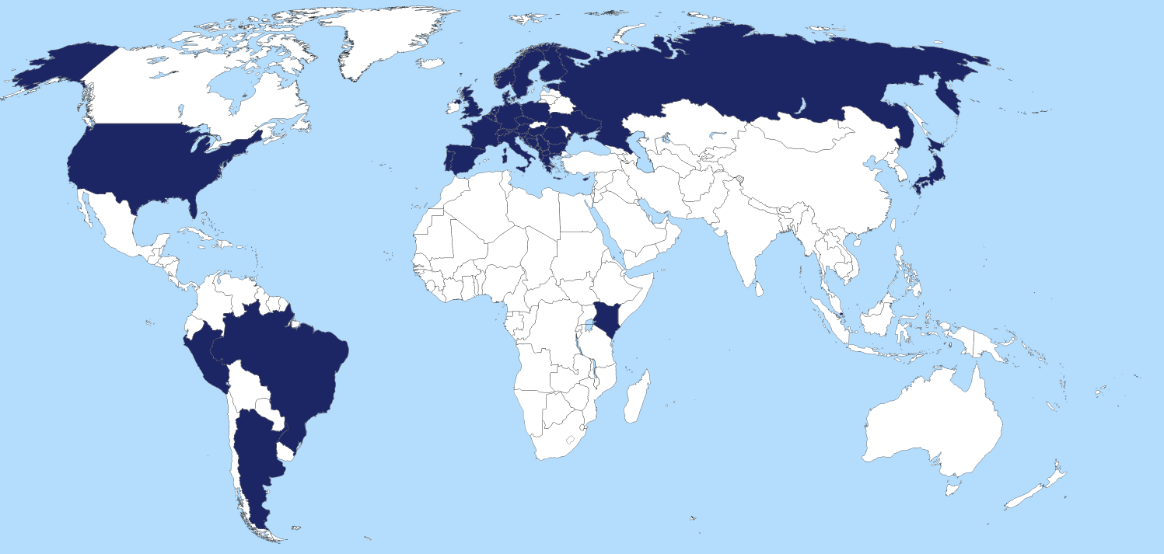
About EBC (3)
benchmarking network of 175 utilities from 40 countries
core market: Western Europe - IB2015: 10th benchmarking edition
since 2012, regional hubs to meet demand for local benchmarking

Slide 6
About EBC (4)
Hub concept for regional benchmarking
local ownership of benchmarking, with central role for national water utility associations
EBC as a joint knowledge centre and facilitator
EBC
Found.
W. EUR
…
BG
…
AL / RSB
IBNet
...
Ex-YU
UA
...
...
Utility benchmarking in Western Europe

Slide 7
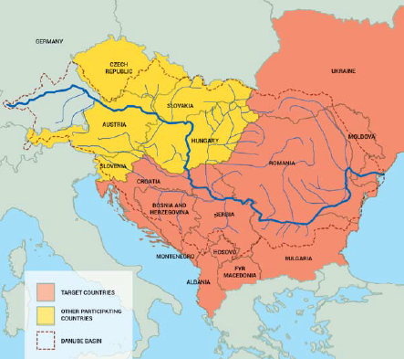
About EBC (5)
Case: Danube Water Programme
capacity building programme for water- & sanitation in Danube region
regional benchmarking hubs for utility improvement in:
  Former Yugoslavia region
  Albania & Kosovo
  Bulgaria
  Ukraine
1st Phase 2014-2015 (56 utilities)
2nd Phase 2016-2018
UA
Ex-Yu
BG
Kos/Alb

Slide 8

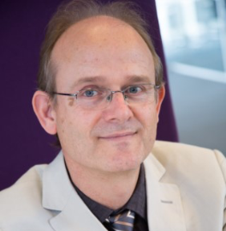
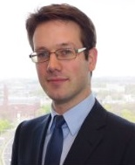
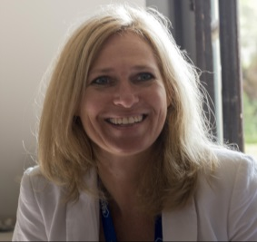

About EBC (6)
The EBC-team
Mr. Peter Dane
Managing director
Mr. Peter Geudens
Methodological support
Mr. Tom Bijkerk
Project co-ordinator
Mrs. Dieneke Krijbolder
Communications/logistics
With support of:

Slide 9
Benchmarking – what is it?
Benchmarking is a tool for performance improvement through systematic search and adaption of leading practices
Task
Level
of
detail
Process
Function
Utility
Performance
ASSESMENT
Performance
IMPROVEMENT
BENCHMARKING

Slide 10
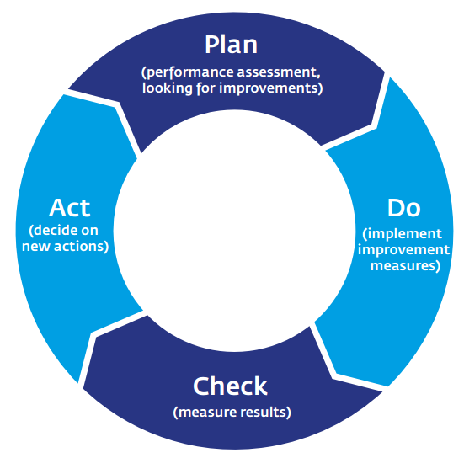
Benchmarking – what is it? (2)
Benchmarking is:
performance assessment and improvement
management tool for continuous improvement

Slide 11
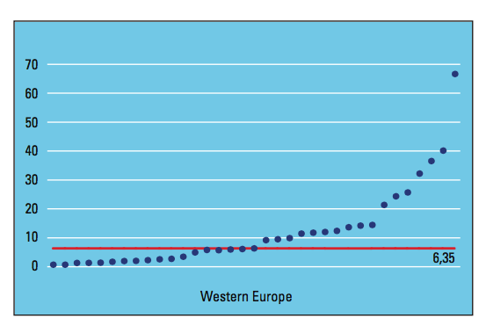

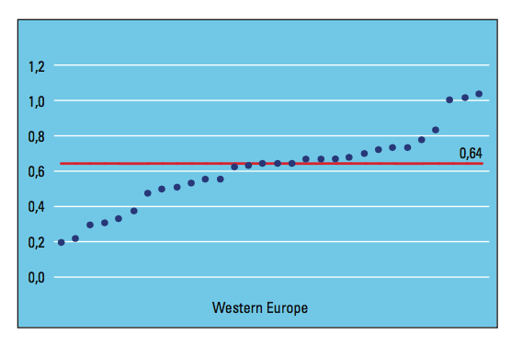

Benchmarking – why should you?
Internal drivers
External drivers

Slide 12

Benchmarking – why should you? (2)
External drivers:
Regulatory pressure
Public pressure
  Right2Water (first successful European Citizens’ Initiative with 1,8 million EU signatures); European Parliament calls for use of benchmarking and increasing transparency
Sustainable Development Goals (UN)
Water Governance Initiative (OECD)

Slide 13



Benchmarking - benefits
Improving by learning
Assess
Learn
Improve

Slide 14



Benchmarking - benefits (2)
Does the instrument work?
clear evidence from documented programmes in f.i. D, DK, NL

Slide 15

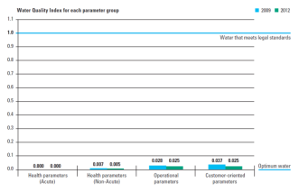
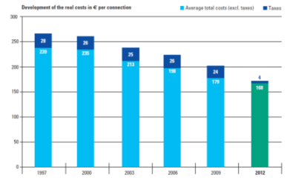
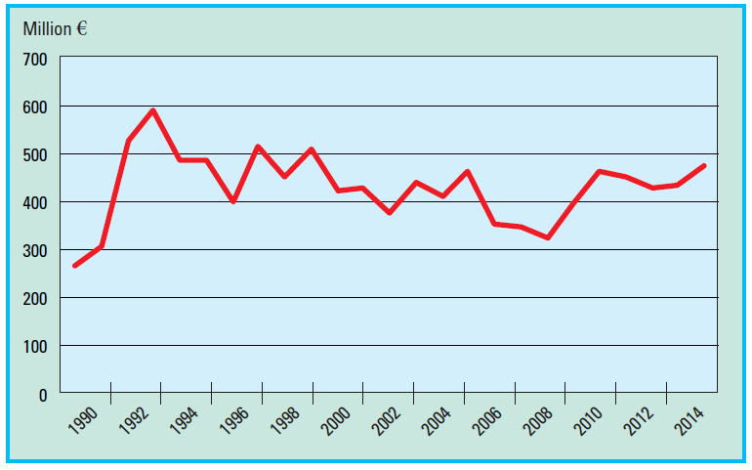
Benchmarking - benefits (3)
Case: benchmarking Dutch water supply (since 1997)
35% cost reduction (corrected for inflation)
still improving the service level
maintaining investment levels
Quality index 2009 - 2012
Cost level 1997 - 2012
Investment level 1990 - 2014

Slide 16
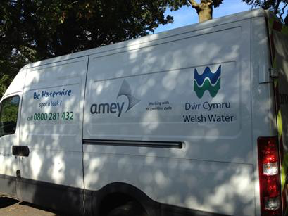
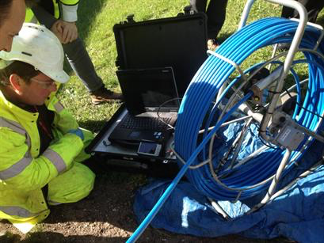
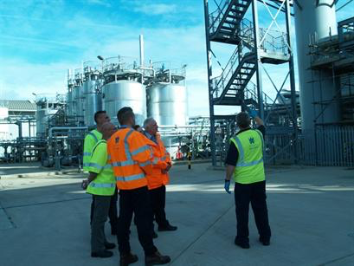
Benchmarking - benefits (4)
Utility case: Oasen mechanics visiting Welsh Water (2013)
Welsh Water accurately records all leaks and repairs conducted in the pipeline on a digital pipeline map. Everything is drawn in, Oasen does not apply this (yet).
Using 'district metered areas' (DMA's): this is not applied at Oasen (yet).
Strong focus on informing the customer and handling complaints. In doing so Welsh Water puts the customer first wherever they can. Oasen can learn from this.

Slide 17
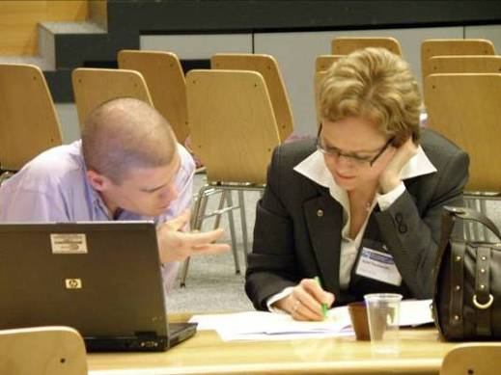
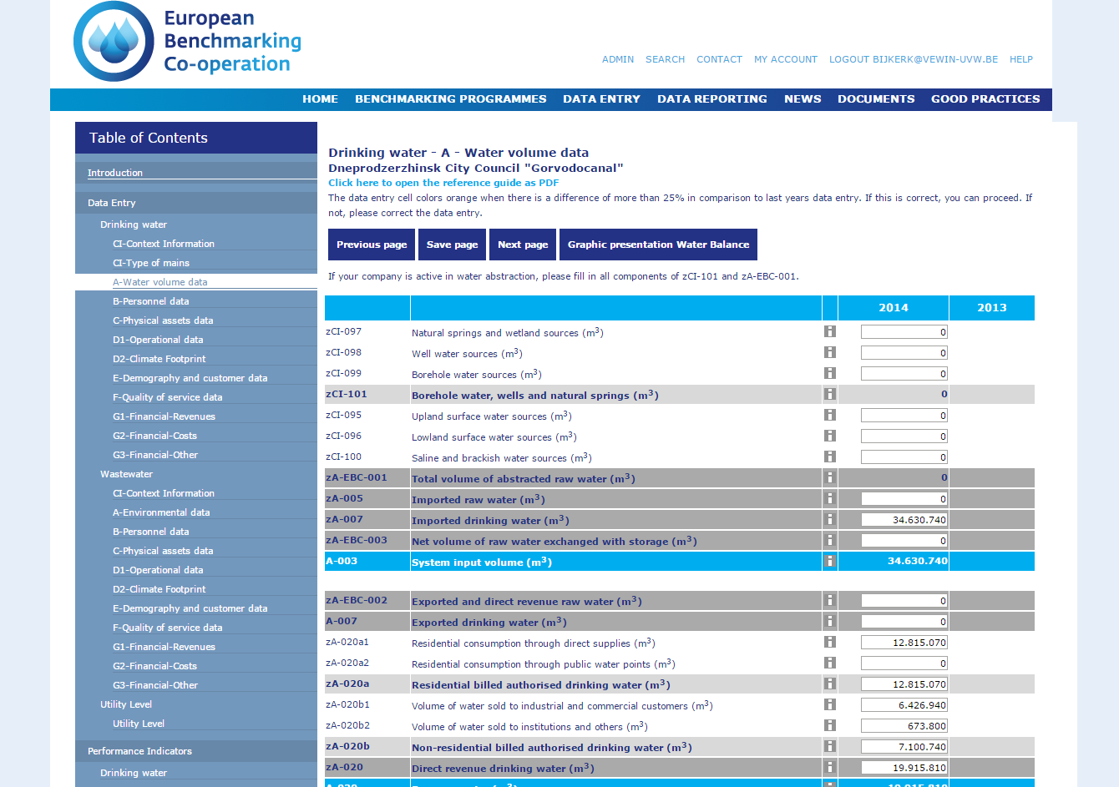
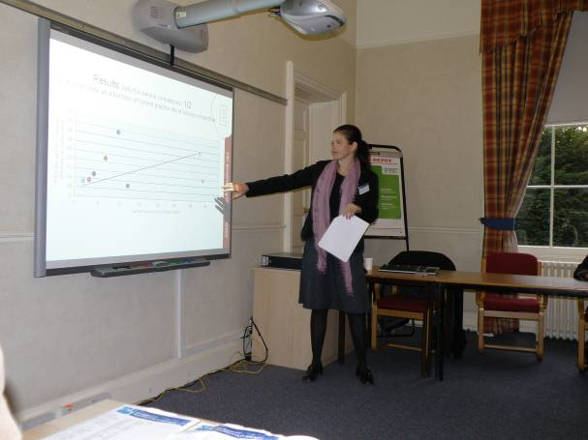
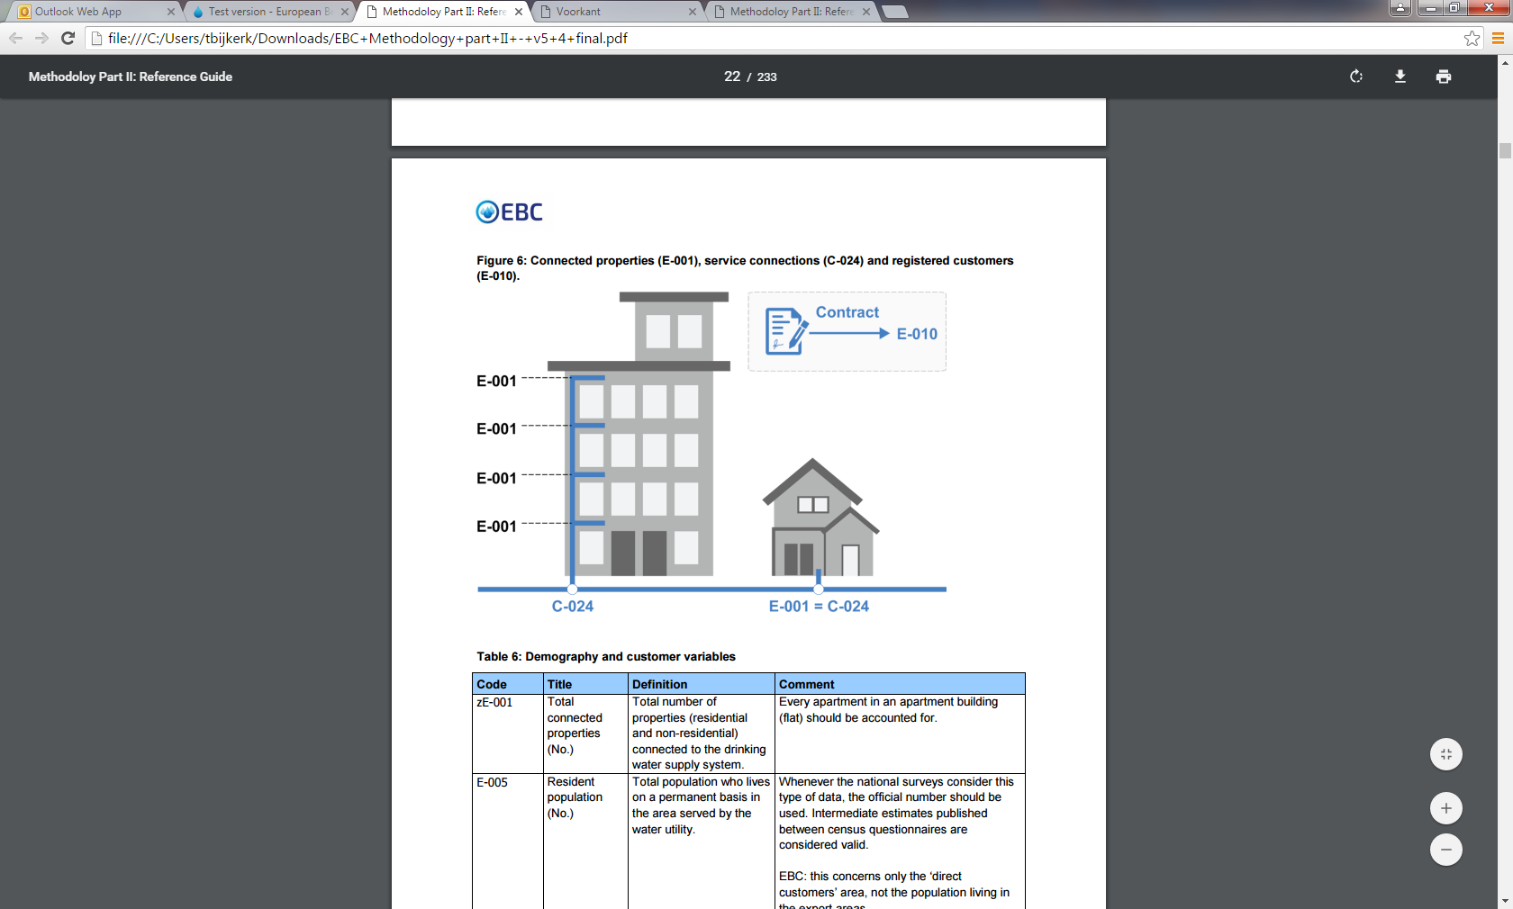
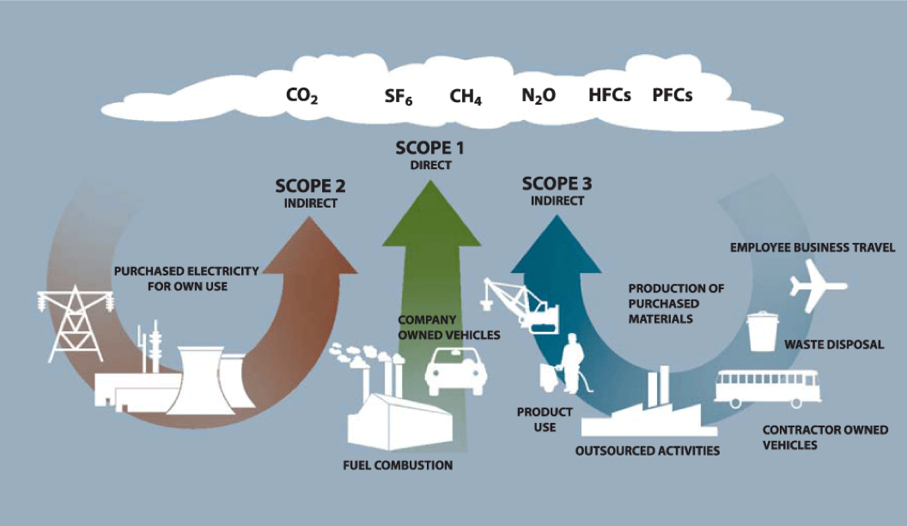
Benchmarking - success factors
  Utility
  commitment of senior management
  alignment with strategic objectives
  stable situation
  sufficient resources
  good data quality
  willing to share experiences and practices
  Facilitator
knowledgeable, competent
trustworthy (confidentiality)

Slide 18

EBC’s benchmarking programme
Seven consecutive steps
Broad view on performance
0
Context information
0
1
1
Water quality
5
2
2
Reliability
3
Service quality
4
Sustainabillity
4
3
5
Finance & efficiency

Slide 19
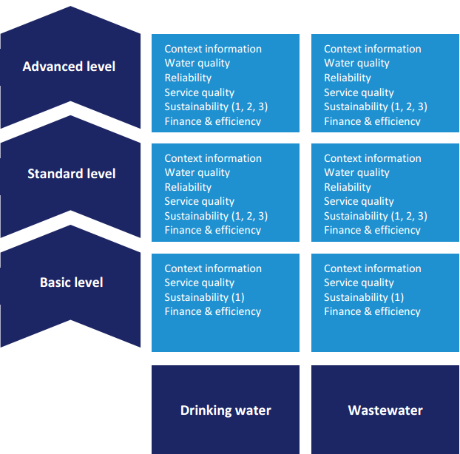
EBC’s benchmarking programme (2)
3 different participation levels

Slide 20
EBC’s benchmarking programme (3)
Example of PI’s at different levels
  Basic level:
    Population coverage
    Total non-revenue water
  Standard level:
    Real losses
    Cost recovery
    Affordability
  Advanced level
    Cost at process level
    Customer lost minutes
    Greenhouse gas emissions

Slide 21

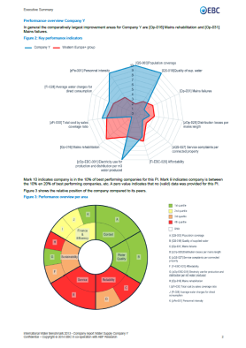
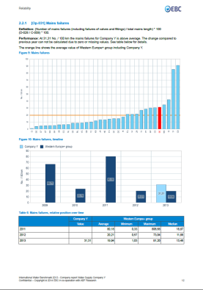
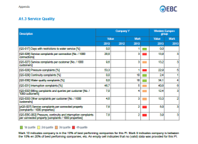
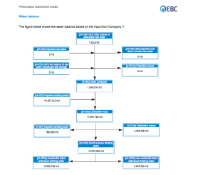
Key deliverables
Individual company report
“dashboard” presentation of key results and detailed comparisons
incl. water balance and financial scheme (“closed systems”)
to check data & identify performance gaps

Slide 22
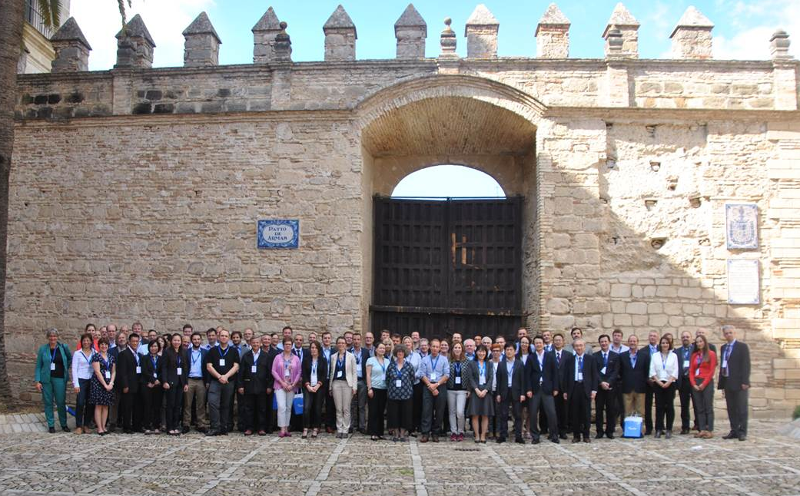
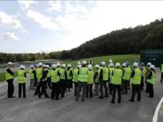

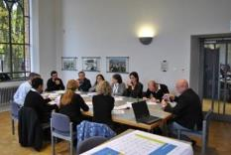
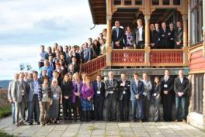
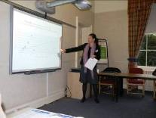
Key deliverables (2)
Annual benchmarking workshop
essential part of the benchmarking exercise - moving from assessment- to improvement stage
discussing (draft) results (data check, understanding PI’s/gaps)
exchanging good practices (presentations by peer utilities)
networking

Slide 23

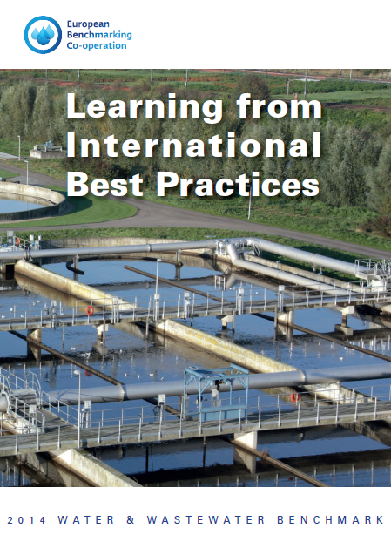




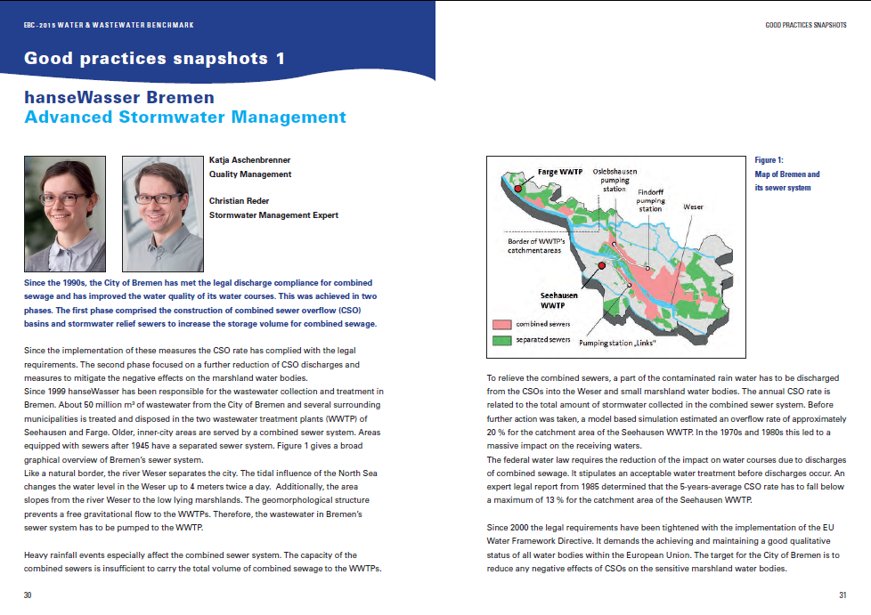
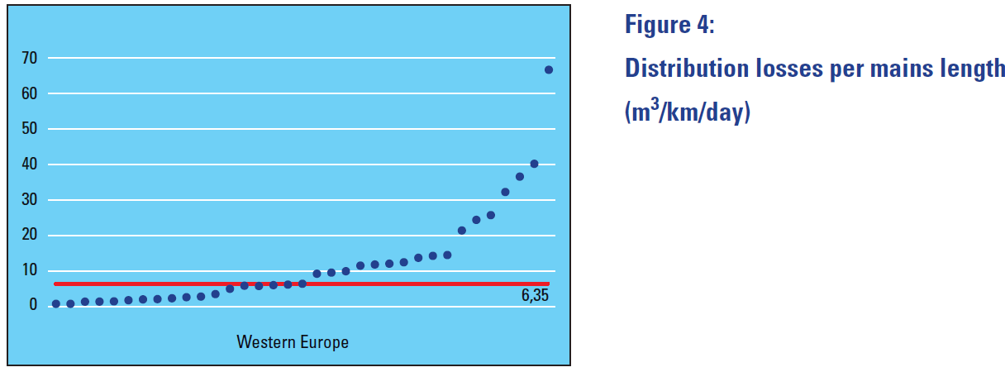
Key deliverables (3)
Public report
shows (anonymous) key results, good practice snapshots & participants experiences
for stakeholder communication, raising transparency & encouraging utilities to join

Slide 24
Planning IB2015
Activities / milestones | Planning
Invitation to register | 27 February 2016
Orientation & training workshop | 19 April 2016
Data collection | 2 May – 15 July 2016
Data validation & -analysis | 15 July – 15 September 2016
Draft reporting | 30 September 2016
Benchmarking workshop | 3 & 4 November 2016
Final reporting | 16 December 2016
Project closure | 31 December 2016

Slide 25
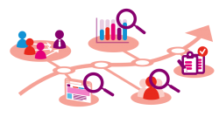
Lessons learned and challenges ahead
Lessons learned
benchmarking is not an easy job
  methodology, definitions, data quality, …
data quality is essential for trusting comparisons and identifying performance gaps
results take time - but efforts pay off!
it all depends on people and their drive to improve

Slide 26
Lessons learned and challenges ahead (2)
Challenges
how to keep utilities interested over time
  commitment from senior management
  focus on continuous improvement
  adapt content to current issues
how to deal with change of staff
funding of the programme
  joint responsibility

Slide 27

Thank you for your attention
More information:
www.waterbenchmark.org
Mr. Peter Dane
EBC Foundation
Koninginnegracht 19
The Hague, Netherlands
peter.dane@waterbenchmark.org

