Slide 1

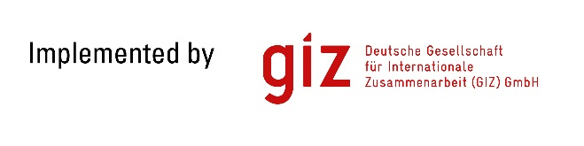

Capacity Development in the Water Sector
in South-East Europe countries
Support of German and
Swiss Government
Initial Benchmarking Workshop 2016
Novi Sad, 19th April 2016
Seite 1

Slide 2
GIZ ORF SEE MMS
GIZ = Deutsche Gesellschaft für Internationale Zusammenarbeit GmbH
    ORF SEE = Open Regional Funds for South-East Europe
          MMS = Modernization of Municipal Services
GIZ
ORF SEE
MMS
Is a 100% federally owned organisation that operates on a public-benefit basis in more than 130 countries worldwide.
Corporate purpose: international cooperation for sustainable development and education activities around the globe.
Employs around 16,500 staff members across the globe, some 70% of whom are employed locally as national personnel.
Volume of business in 2014: EUR 1.9 billion
Water
4 Projects
Solid waste
2 Projects
Economic development
2 Projects
GIZ
Consumers
  1 Project
Seite 2

Slide 3
Open Regional Funds for South-East Europe (ORF SEE)…
When?
Why?
How?
What?
Who?
Established in January 2007.
Successful bilateral stories are taken to a regional level to build the capacities and to support EU integration through regional projects.
As a flexible advisory instrument, ORFs initiate and promote sustainable regional cooperation.
Advises partners in project development, technical issues and project management by providing services such as network building, knowledge management and training to enhance cooperation in dealing with the challenges of regional integration.
Public and private organisations as well as civil society of the SEE countries – Albania, Bosnia and Herzegovina, Croatia, Kosovo, Macedonia, Montenegro and Serbia.
…new ways for regional cooperation
Seite 3

Slide 4
Open Regional Funds for South-East Europe
ORF sectors
Energy Efficiency
Biodiversity (from 2015)
Legal Reform
Foreign Trade Promotion
Modernization of Municipal Services
Water & waste water related service
ORF EU Integration module - supports the sector ORFs through measures for the development and management of networks and strengthens the joint focus on EU integration
Seite 4

Slide 5
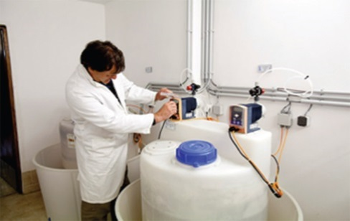

GIZ Open Regional Funds South-East Europe
Modernization of Municiapal Services
Commissioned by: German Federal Ministry for Economic Cooperation and Development (BMZ) / Swiss Agency for Development and Cooperation (SDC)
Countries: Albania, Bosnia and Herzegovina, Kosovo, Macedonia, Montenegro and Serbia
Duration: Phase I 2007 – 2013 / Phase II 2013 – 2016 / Phase III 2016 – 2018
Focus Areas: water supply and disposal, waste management, improvement of the range of services offered by municipalities, and capacity building for municipal management structures.
Total Budget: 9,5 M€
Seite 5

Slide 6
List of ORF MMS Projects
related to Water and Waste Water Sector
Asset Management in Water and Sanitation Sector in South-East Europe
Regional Dialogue Platform on Water and Waste Water in South-East Europe
Regional Benchmarking Platform for Water and Waste Water Sector in South-East Europe
Reduction of Non-Revenue Water in South-East Europe
Seite 6

Slide 7

Asset Management in Water and Sanitation
Sector in South-East Europe – AM WSS SEE
Duration of the project: 11/2013 – 05/2016
Budget: 500,000 €
Implementing partner: NALAS Secretariat (Network of Associations of Local authorities in South-East Europe)
Project partners: National LGAs and PUAs in SEE, pilot PUs, DWP
Project objective: The introduction of Asset Management methods in Pilot municipalities improves efficiency and transparency in managing water and sanitation infrastructures in SEE.
Project products: AM Regional Report, AM Toolkit, e-learning course, Business planning decision supporting tool for AM
Seite 7

Slide 8

2. Regional Dialogue Platform on Water and Waste
Water in South-East Europe – RDP WSS SEE
Duration of the project: 09/2014 – 01/2016
Budget: 500,000 €
Implementing partner: IAWD Secretariat (International association of water supply companies in the Danube River Catchment Area)
Project partners: National LGAs and PUAs in SEE, NALAS, IBNet, DWP
Project objective: A regional dialogue among relevant stakeholders in SEE on goals, strategies, concepts, roles and practices in the water and waste water sector is institutionalized.
Seite 8

Slide 9
3. Regional Benchmarking Platform for Water and Waste Water Sector in South-East Europe – RBP WSS SEE
Duration of the project: 09/2014 – 01/2016
Budget: 570,000 €
Implementing partner: IAWD Secretariat (International association of water supply companies in the Danube River Catchment Area)
Project partners: National LGAs and PUAs in SEE, NALAS, IBNet, EBC, DWP
Project objective: Utility performance data is made available to professionals and decision makers from both governmental and local governmental bodies and utilities to improve the water services.
Seite 9

Slide 10

4. Reduction of Non-Revenue Water in
South-East Europe – NRW SEE
Duration of the project: 2015 – 2016
Budget: 450,000 €
Implementing partner: AQUASAN Network (Bosnia and Herzegovina)
Project partners: National LGAs and PUAs in SEE, 9 WUs, NALAS, IAWD
Project objective: Managerial capacities for NRW reduction in SEE are strengthened.
Seite 10

Slide 11


MoU for cooperation between ORF / LL SEE and DWP
MoU
Implementation
Period
2013 – 2015
Total budget
3,120,000 €
Development and dissemination of Asset Management Methods
Establishment and management of a Regional Dialog Platform on WSS
Development of a regional WSS benchmarking platform
770,000 €
1,200,000 €
1,150,000 €
Seite 11

Slide 12
Oliver Nachevski oliver.nachevski@giz.de
GIZ ORF MMS
Project Manager
Vielen dank! Мultumesc!
Thank you!
Ju faleminderit!
Хвала! Hvala! Благодаря!
Ви благодарам!
Ευχαριστώ!
Спасибo!
            Dankon!
Seite 12

