Slide 1
Advanced benchmarking for utility improvement
Peter Dane
19 April 2016
YOUR PORTAL TO EUROPEAN BEST PRACTICES

Slide 2
Content
The roadmap to improvement
Measuring performance
  the information pyramid
  example of IBNet
  example of EBC
To conclude

Slide 3
The roadmap to improvement
Define utility objectives
Water quality (Re: European Drinking Water Directive, Water Framework Directive, national standards)
Reliability (condition of infrastructure)
Service quality
Environmental impact (water use, energy consumption, carbon footprint)
Health and safety
Security
Efficiency

Slide 4

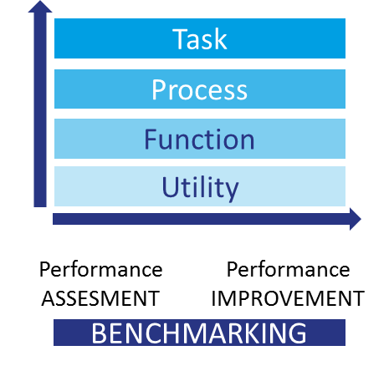
The roadmap to improvement (2)
Measure performance on the areas of interest
choose the right level of detail
choose the right indicators
well described in IWA benchmarking manuals

Slide 5
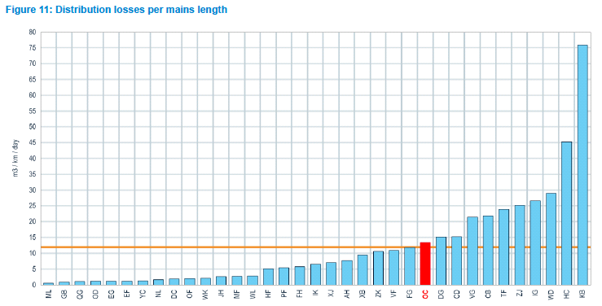
The roadmap to improvement (3)
Identify performance gaps
compare your own performance over time
compare with comparable other utilities - consider differences in the operating environment

Slide 6
The roadmap to improvement (4)
Prepare a Utility Improvement Plan
develop measures for the identified performance gaps, for instance based on good practices from colleague utilities
set priorities - you cannot implement all necessary measures at the same time
prioritise measures according to the contribution of a measure to reaching the objectives and the costs (impact analysis)

Slide 7
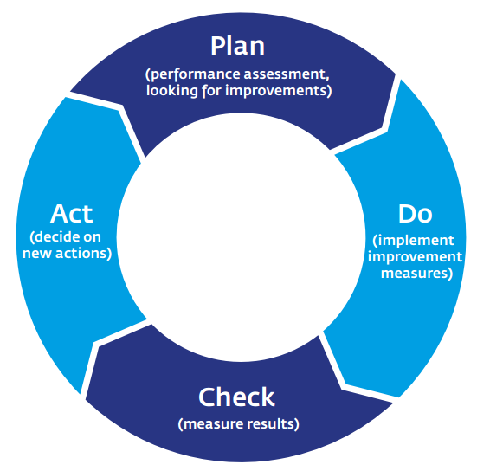
The roadmap to improvement (5)
Implement measures and measure the effect
if the result is not good enough, take extra measures
continuous plan-do-check-act cycle

Slide 8
Measuring performance - the information pyramid

Slide 9
Measuring performance - the information pyramid (2)
highly aggregated information: for statistics, policy making and strategy (f.i. service coverage at national/European level)
the more detailed the information, the more you can learn from it to improve the business (for instance real losses in the network)

Slide 10
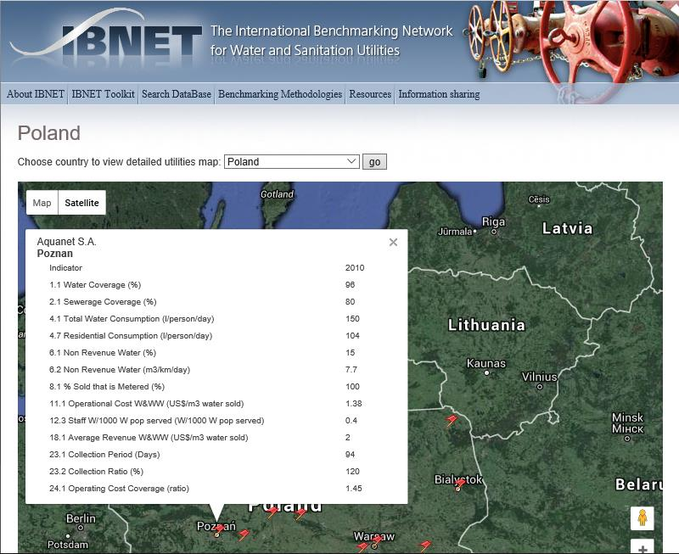
Measuring performance – example of IBNet
global largest database with performance data of water- and wastewater utilities
basic set of data, primarily designed for statistics & policy making (f.i. coverage, non-revenue water, operational cost at utility level)

Slide 11
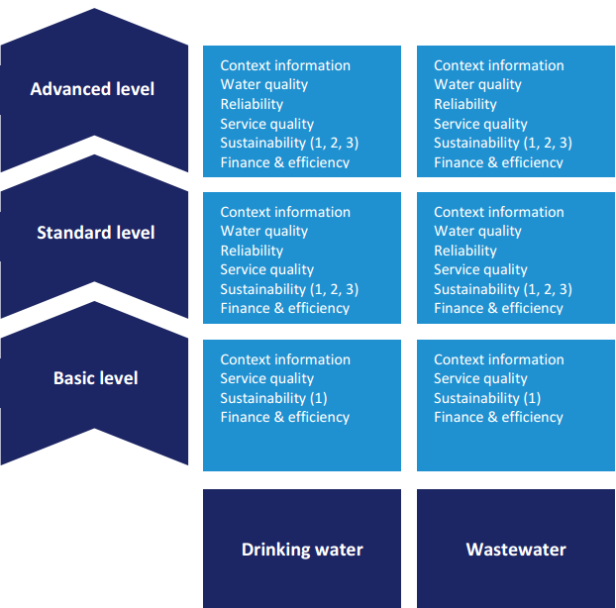
Measuring performance – example of EBC
3 different participation levels
accommodates all types/ sizes of utilities
from basic (utility level) to advanced level (process level)
primarily designed for utility improvement

Slide 12
Measuring performance – example of EBC (2)
Example of PI’s at different levels
  Basic level:
    population coverage
    total non-revenue water
  Standard level:
    real losses
    cost recovery
    affordability
  Advanced level
    cost at process level
    customer lost minutes
    greenhouse gas emissions

Slide 13

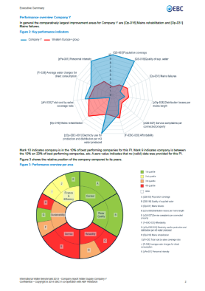
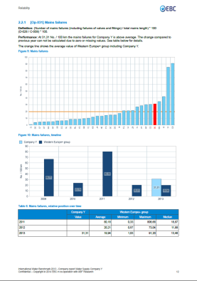
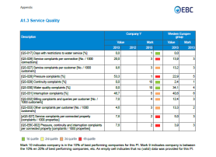
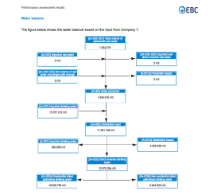
Measuring performance – example of EBC (3)
Individual company report
“dashboard” presentation of key results and detailed comparisons
incl. water balance and financial scheme (“closed systems”)
to check data & identify performance gaps

Slide 14
To conclude
road to improvement starts with defining utility objectives (strategic plan)
data collection is no target on its own – stick to what is necessary to measure for performance assessment
start simple, work on good data quality and move to more advanced benchmarking for maximal learning effect

